Slide 1

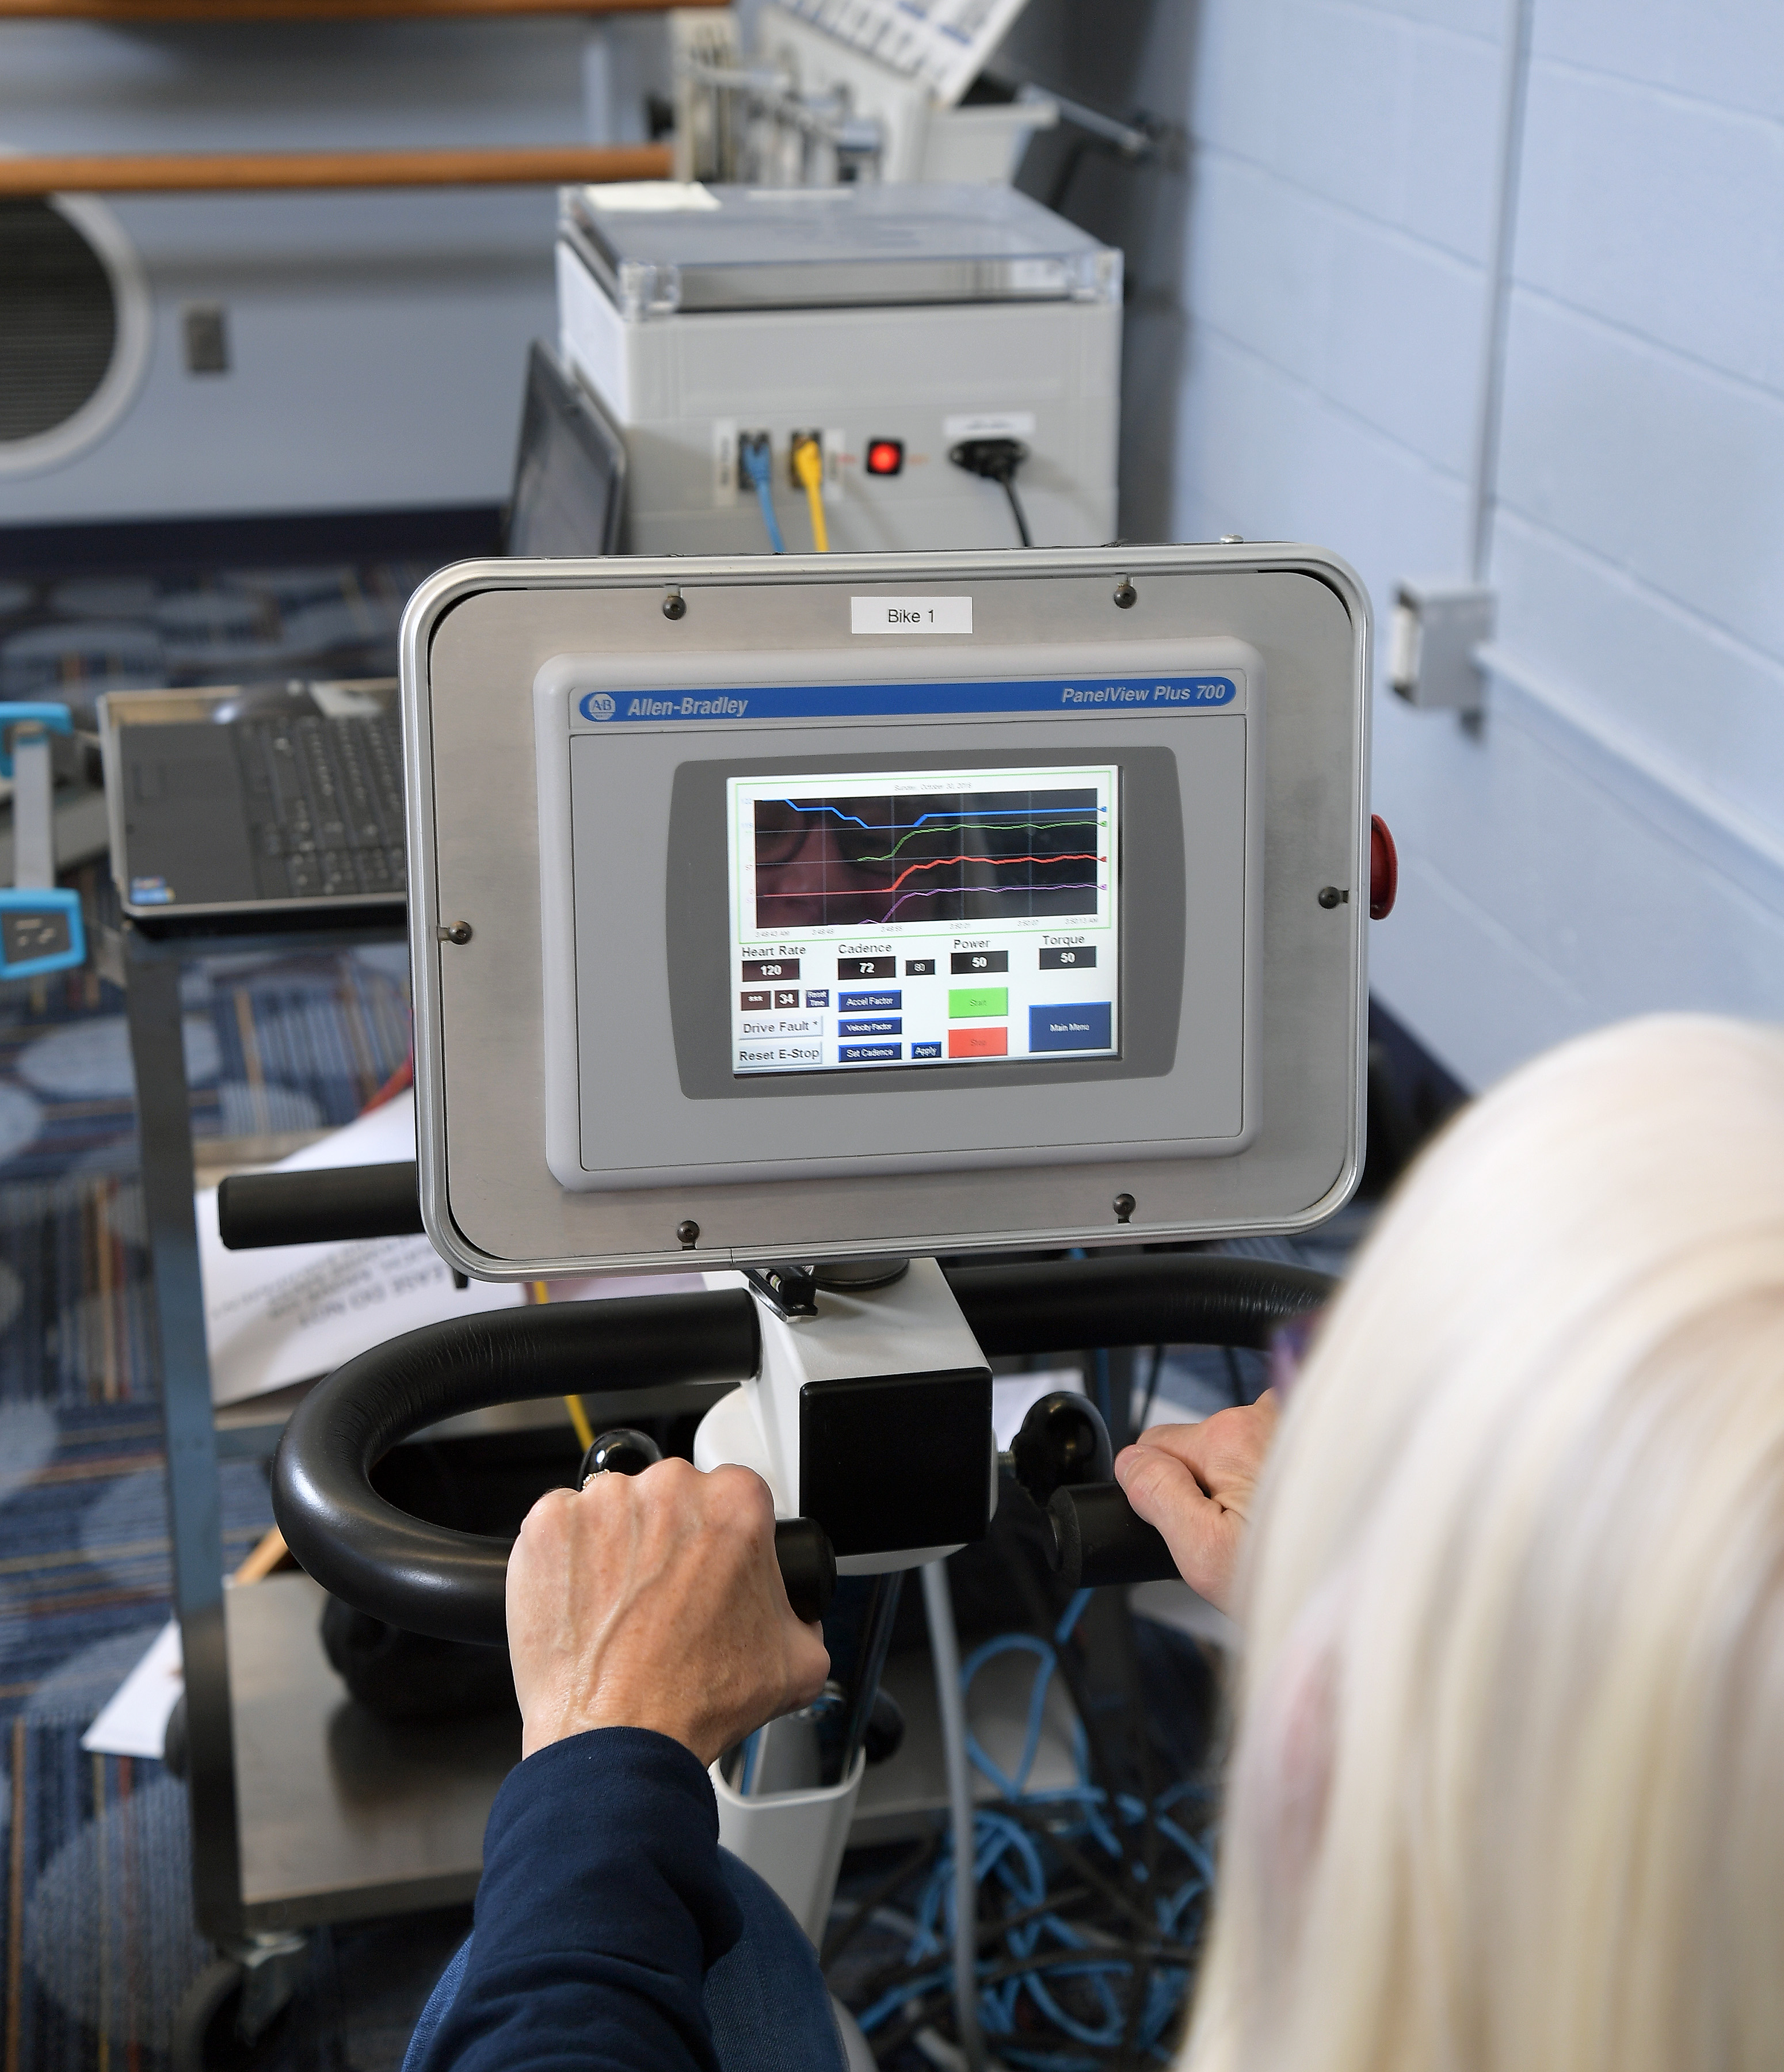
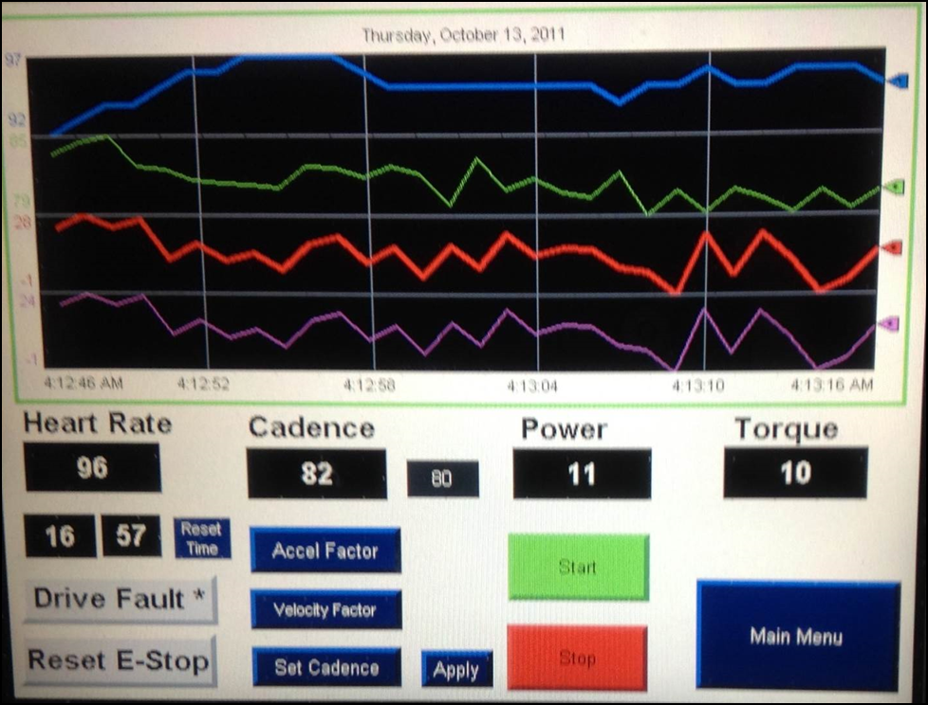
DOES High-cadence Cycling IMPROVE Depression in Individuals with Parkinson’s Disease?
Alena J. Varner, Bryan T. Dowdell, Jin Hyun Kim, Sara A. Harper, Brandon S. Pollock, Angela L. Ridgel, FACSM
Kent State University, Kent, OH USA
ABSTRACT
PROTOCOL
RESULTS-BDI-II
DEPRESSION/ANXIETY/STRESS
Parkinson’s disease (PD) is a progressive neurodegenerative disorder that often leads to increased incidence of depression. Although high cadence cycling improves motor function in PD, depression could decrease motivation to participate in exercise. PURPOSE: To examine if three bouts of high-cadence cycling improves symptoms of depression in individuals with PD. METHODS: Individuals with PD (N=32) were divided into either a high-cadence cycling or a no-exercise (control) group. The cycling group completed three sessions of high cadence cycling, on a custom motorized stationary cycle, consisting of a 5-minute warm-up at 50 revolutions per minute (rpm), 30 minutes of high cadence cycling between 75-85 rpm, and a 5-minute cool down. Depression was assessed using Beck Depression Inventory (BDI-II) at baseline and 1 week later. BDI-II is a 21-question self-assessment that examines feelings of hopelessness, irritability and fatigue. RESULTS: At baseline, 31% of the individuals showed symptoms of depression. Overall, there were no significant changes in BDI scores after the intervention. However, not all of the subjects recruited had depression according to the BDI. Individuals who showed symptoms of depression (BDI score > 13) improved their depression score by 4.67 points after high-cadence cycling and the control group only improved by 2.75 points. CONCLUSIONS: This cohort of individuals showed a high incidence of depression. Although three high-cadence cycling sessions did not result in significant improvements in BDI-II, it is possible that additional sessions of high-cadence cycling will promote further improvements in depression amongst individuals with PD. Future studies should examine the effects of additional cycling sessions on depression in this high-risk population.
Baseline Beck Depression Inventory (BDI-II)
Three 40 minute sessions separated by 48 hours
5 minute warm-up, 30 minute high-cadence motorized cycling at 80 rpm, 5 minute cool-down¹
72 hours after the third session, BDI-II assessment was repeated
Control group did not exercise but were tested with the same timing
BDI-II is a self-reported 21 item survey that evaluates the presence and severity of depression
Online questionnaires addressed stress, anxiety and depressed mood (Depression, Anxiety and Stress Scale, DASS)
STEN (standard 10) scores have midpoint average of 5.5
Day 1
Pre-Testing
Cycling
Day 2
Cycling
48 HRS
BDI-II Score Change Pre-Post. There was no significant change in the scores in the cycling or the control group. However, the majority of the subjects did not show symptoms of depression.
Day 3
Cycling
PURPOSE
48 HRS
Day 4
Post-Testing
Severe
72 HRS
Moderate
To examine if three bouts of high-cadence cycling improves symptoms of depression in individuals with PD.
Mild
 | CYCLING Mean ± SD (N=20) | CONTROL Mean ± SD (N=15)
Age (yrs) | 64.2 ± 89.3 | 64.8 ± 6.9
Height (in) | 66.5 ± 4.2 | 67.7 ± 3.6
Weight (lbs) | 165.9 ± 38.1 | 195.5 ± 35.8
BMI | 26.1 ± 4.5 | 29.9 ± 4.2
Years of Education | 15.2 ± 1.9 | 15.6 ± 2.0
Minimal
DEPRESSION IN PD
CONCLUSIONS/FUTURE DIRECTIONS
Baseline BDI-II scores in the cycling group. 6 out of 20 subjects (30%) show symptoms of depression.
Symptoms of depression can include but are not limited to hopelessness, anxiety, loss of interest, irritability, and suicidal thoughts.
30-50% of individuals with PD suffer from depression¹
Brain derived neurotrophic factor (BDNF) is reduced in people with depression and PD¹
Exercise has been shown to increase the release of BDNF²
There were no significant differences in pre/post depression in neither the cycling nor the control group.
However, individuals with signs of depression showed greater improvements in BDI-II scores after cycling.
Variations in responses are likely due to the presence and degree of depression in this population.
Future studies should recruit individuals with depression (>14 BDI-II) in order to determine if high-cadence cycling can improve symptoms.
HIGH CADENCE CYCLING
Moderate
 | Session 1 Mean ± SD | Session 2 Mean ± SD | Session 3 Mean ± SD
Cadence (rpm) | 80.6 ± 4.3 | 79.7 ± 4.8 | 77.8 ± 8.4
Power | 7.3 ± 26.3 | 1.3 ± 30.5 | 0.8 ± 25.6
Heart rate (bpm) | 84.4 ± 11.4 | 85.7 ± 13.1 | 89.6 ± 14.1
RPE (6-20) | 10.8 ± 2.4 | 11.0 ± 2.6 | 11.2 ± 2.3
Mild
Minimal
ACKNOWLEDGEMENTS
Baseline BDI-II scores in the control group. 4 out of 15 subjects (26%) show symptoms of depression.
Funding: Kent State University’s School of Health Sciences, Midwest American College of Sports Medicine, Ohio Parkinson Foundation Northeast Region Grant, KSU Undergraduate Student Senate.
Kelsey Yankush, Mariana Morales-Najera, Nick Schank, Jacob Gross, Evan Haskins, Sara Formoso
REFERENCES
1) Aarsland, D., et al. (2012). "Depression in Parkinson disease--epidemiology, mechanisms and management." Nat Rev Neurol 8(1): 35-47.
2) Hirsch, M. A., et al. (2016). "Exercise-induced neuroplasticity in human Parkinson's disease: What is the evidence telling us?" Parkinsonism Relat Disord 22 Suppl 1: S78-81.
From: Aarsland et al. 2012¹
In individuals with depression, the cycling group showed a 4.6 point improvement and the control group improved by 2.7 points.

