Slide 1
Delineating a Pathway for TRP Channel-Induced Nitric Oxide Production in Diabetic Cardiomyocytes

Slide 2
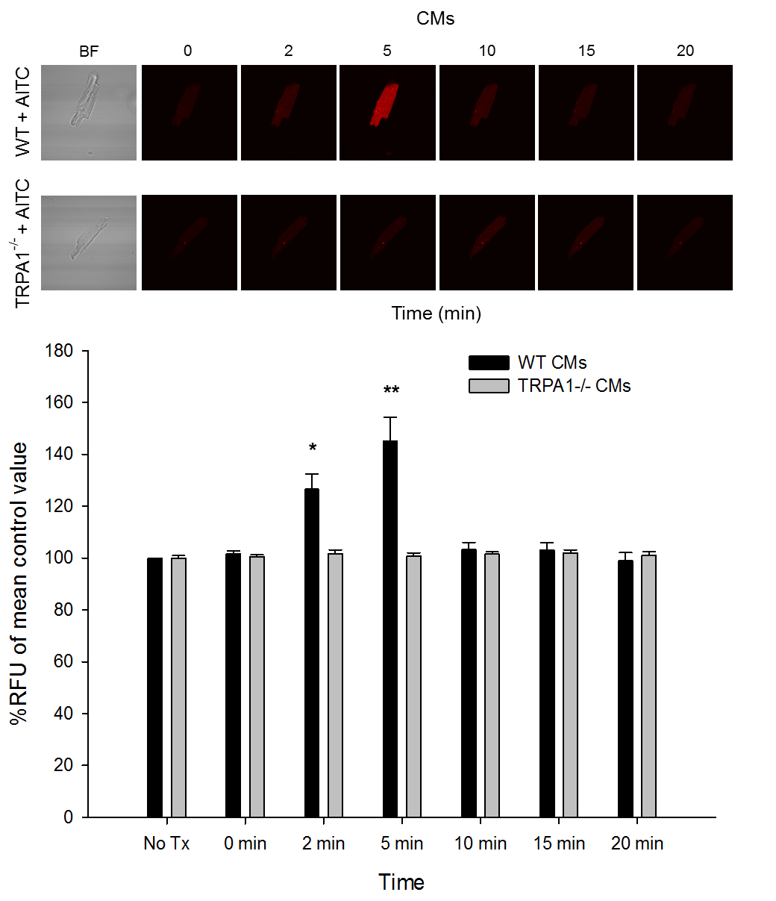

Slide 7
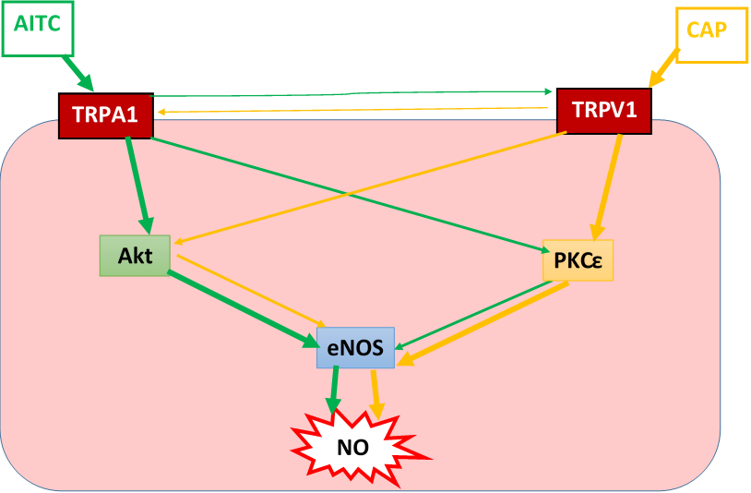
Insert Schematic Diagram

